Slide 1




Slide 2
Urban-Level 90-90-90 Targets: Progress and Experience from Thailand
Praphan Phanuphak, MD, PhD
Professor Emeritus, Faculty of Medicine, Chulalongkorn University
Director, the Thai Red Cross AIDS Research Centre

Slide 3
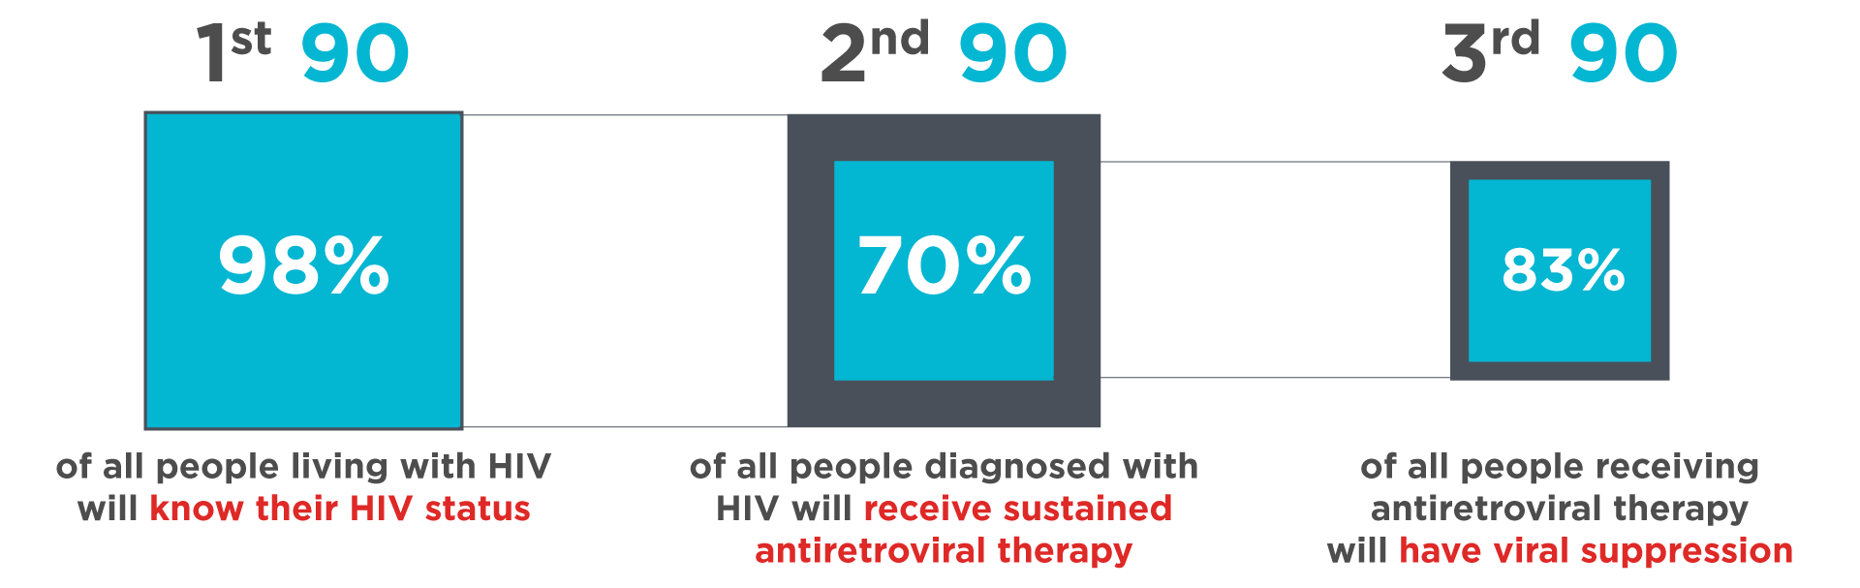
Thailand Treatment Cascade: 2017
Bangkok: 91 70 76
Source: National AIDS Program web report: National Health Security Office: 31 December 2018
Notes:
Slide 10 of the script
AS: I think the text boxes with the sources of the data should all be in the same space to the extent possible. That is either to the far left or far right at the bottom of the slide and the same font size as much as possible.
I also would revise the text here since the CROI audience does not know these groups. As below. - DONE
Source: National AIDS Program web report: National Health and Security Office, 31 December 2018

Slide 4
We still need to do more to find those who are not yet diagnosed
The strategies of the Thai Red Cross AIDS Research Centre in reaching difficult-to-reach populations (key population) for HIV testing, prevention and care in Bangkok
  Men’s (MSM) health clinic using anal Pap smear as induction
  Transgender health clinic (Tangerine Clinic) using sex hormones monitoring as induction
  Key population-LED health services (KPLHS) using key population as induction

Slide 5
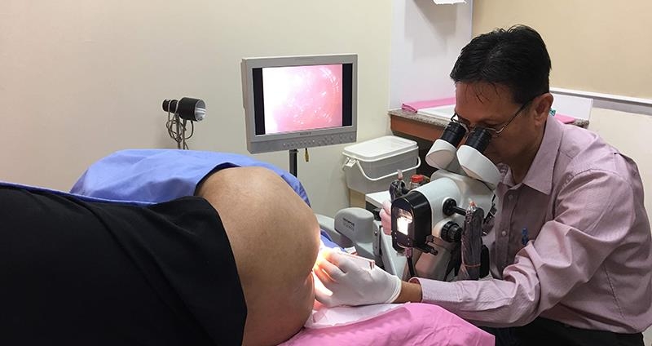
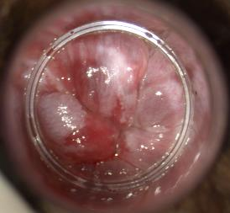
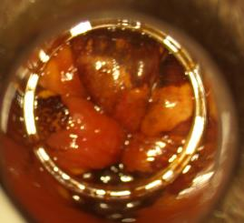
Using Anal Pap and STI service as entry point for HIV testing for MSM: Example of PICT
Among 1,429 MSM clients in 2009
  52% known HIV+ve, 35% known HIV-ve, &13% never tested
Previous HIV status | STI MSM clients |  | Anal Pap MSM clients
 | HIV-ve | Unknown | HIV-ve | Unknown
Acceptance of HIV testing | 34% | 98% | 77% | 85%
% tested +ve for HIV | 8% | 13% | 13% | 33%
Using screening for anal pre-cancerous lesions as “entry point” for HIV testing
High-grade anal pre-cancerous lesions

Slide 6
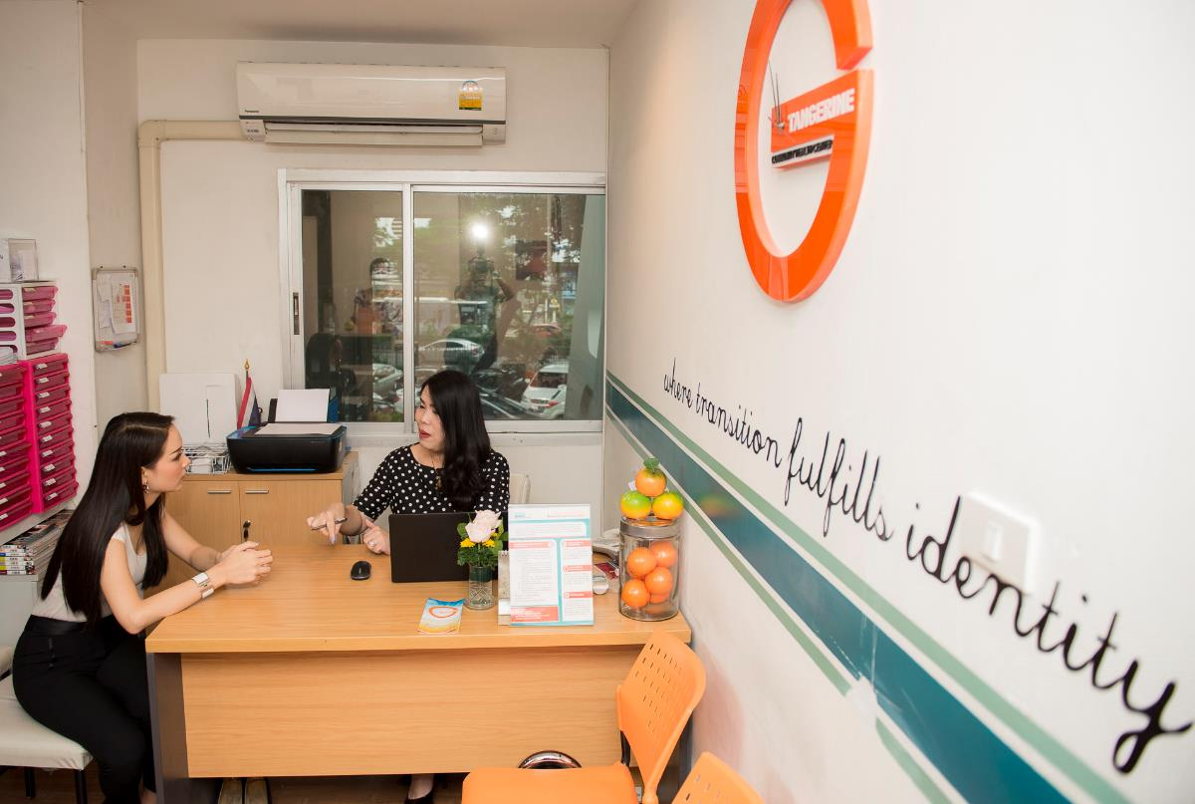




“Tangerine Community Health Center”:
Trans-led, integrated, hormone and sexual health services
Notes:
With growing need for the country and the government to have transgender-specific data to inform policy, the TRCARC established the Tangerine Clinic last year to provide trans-led, integrated, hormone therapy and sexual health services to both transwomen and transmen.
HIV prevalence among 300 transwomen clients up to now was 9%. 16% had sexual reassignment surgery and a look at subset of transwomen post-surgery revealed that around 80% had neovaginal sex and one fifth carried oncogenic HPV types in the neovagina. None had neovaginal exam after surgery and a few had warts or foreign bodies inside it. Every woman was very satisfied with the exam. Data from the Tangerine Clinic will further inform us on how long-term sexual health care should be provided for these women in Thailand.
The Tangerine team has also recently reached out to TG community-based organizations to strengthen the capacities of TG lay providers to provide hormone monitoring services, in addition to just providing HIV testing and PrEP, to their clients with an aim to enhance adherence and retention of TG PrEP users and TG ART clients in HIV prevention and treatment programs.

Slide 7
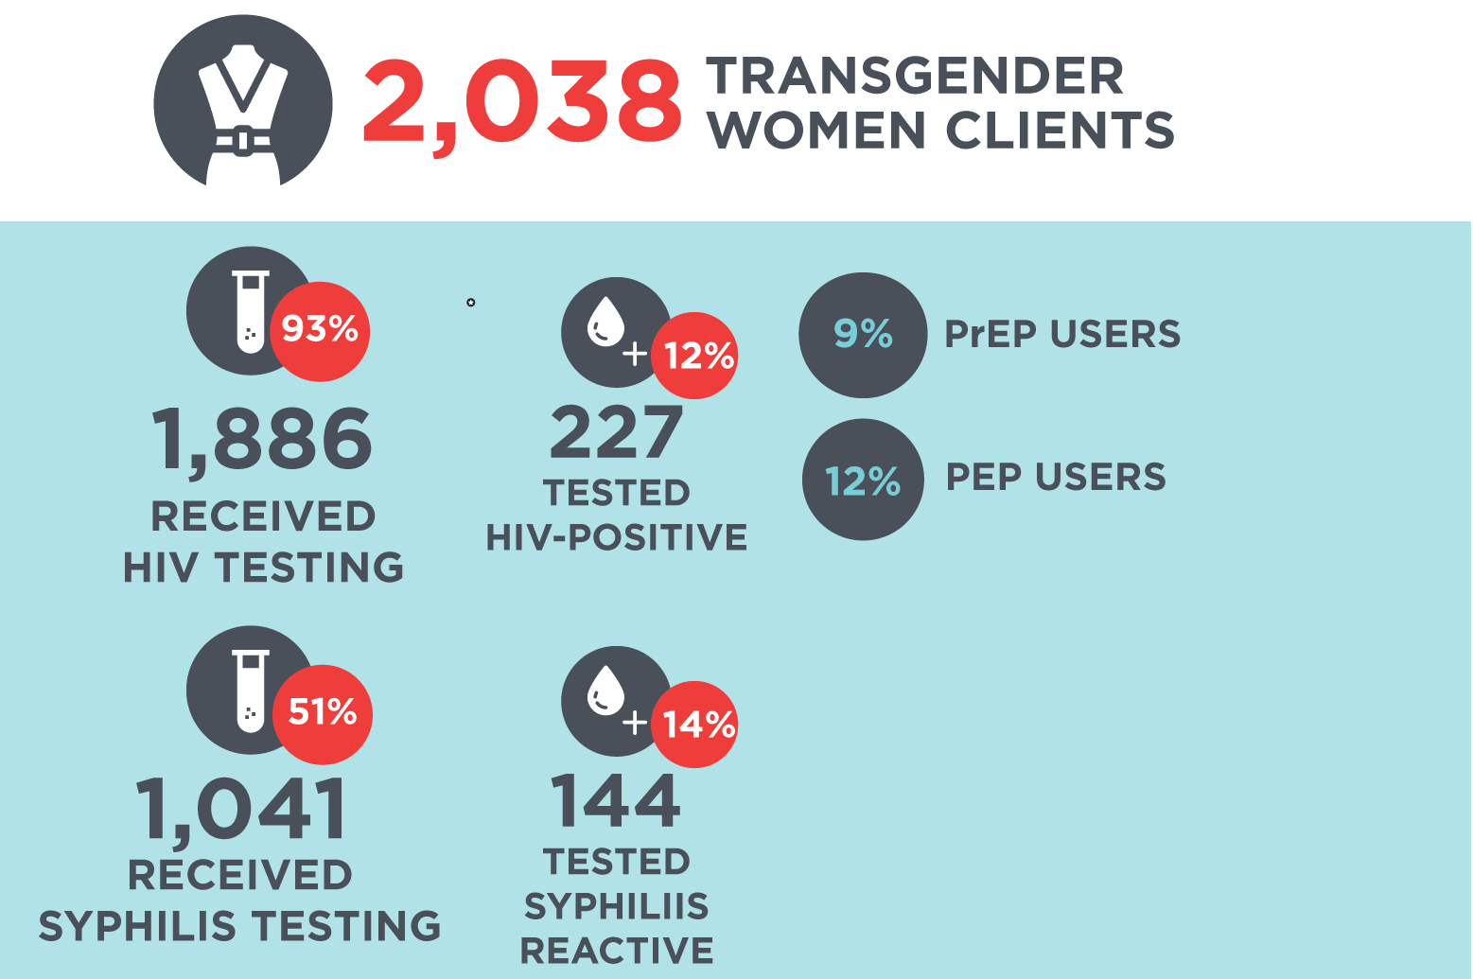
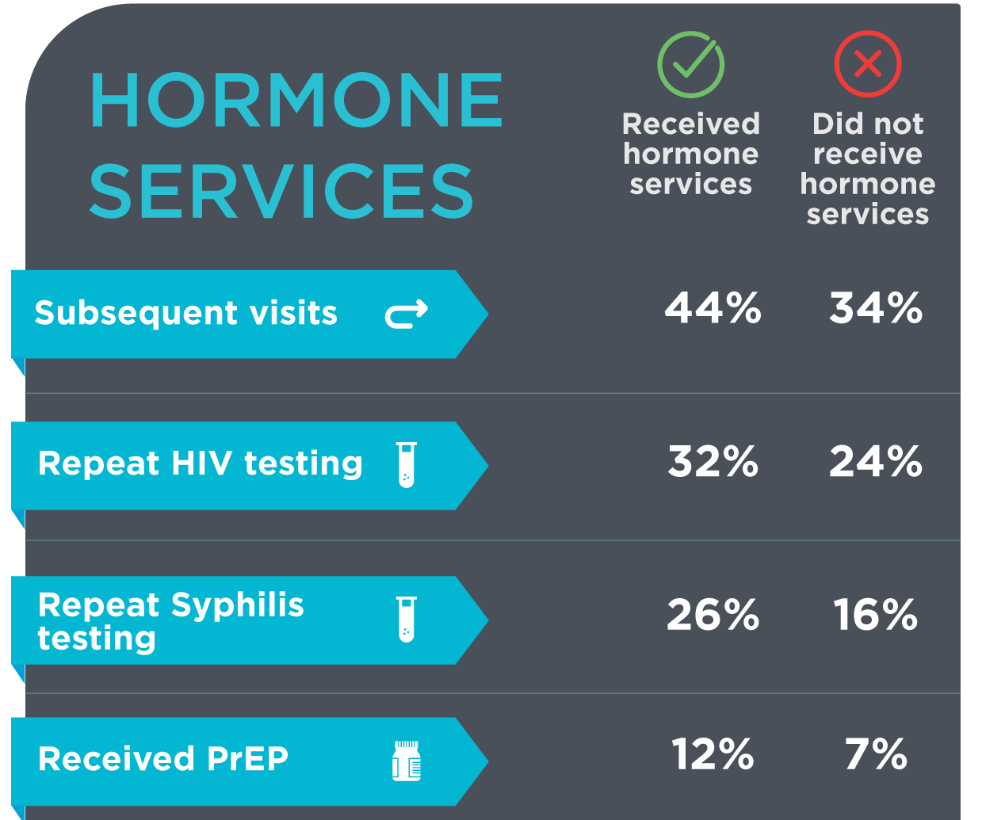
Tangerine Clinic clients, up to December 2018 (3 yrs.)
Notes:
Hormone / prep uptake
Add trans pho
= SLIDE # 16 on the script_PP
AS: have revised title; on right graphic change to “Received PrEP” with a ‘d’ _ OK

Slide 8
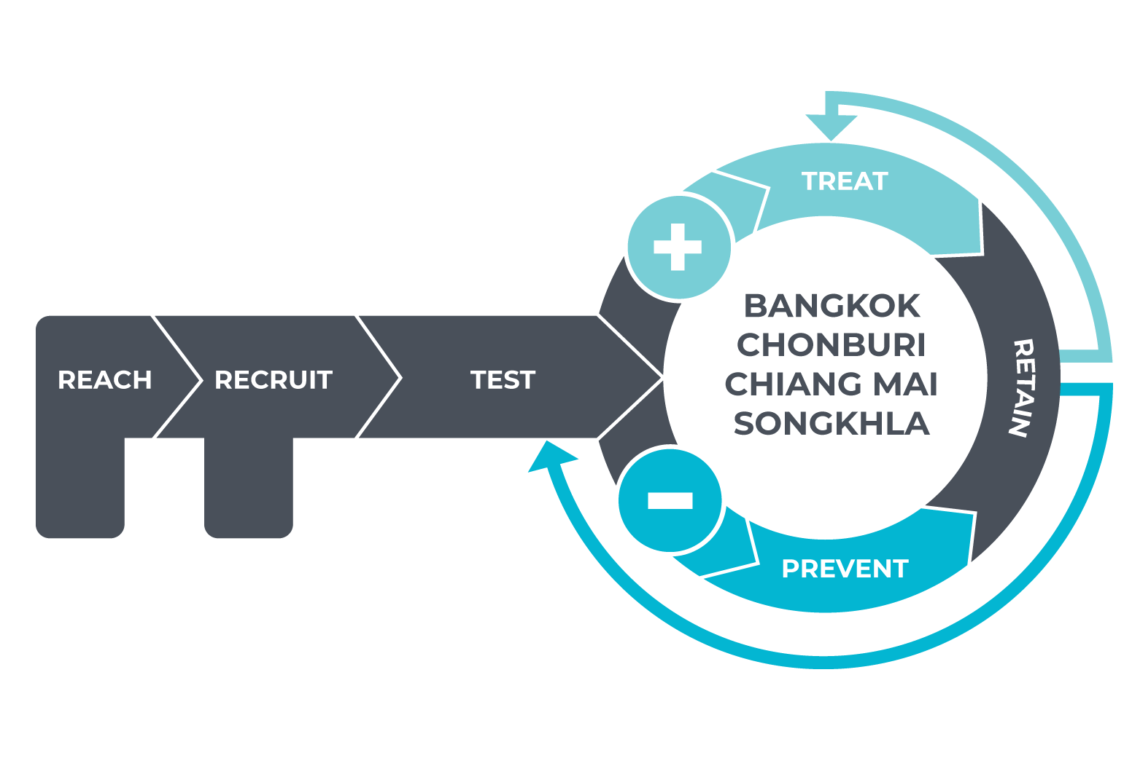

KP-led health services: Differentiated service delivery along the Reach-Recruit-Test-Treat-Prevent-Retain cascade
Notes:
AS: have revised the title. I think KPLHS is too complex an acronym _ Very Nice.
Please revise CHIANGMAI to CHIANG MAI
Revise graphic on the right: top bullet – delete “All”; for the 3rd bullet, I don’t understand if these are PrEP users nationwifde by mid-2018? It is different from the other 2 bullets above them; did all of these people receive services at the community health centers? If you are saying “nationwide” but that only applies to KPLHS sites, then it is not quite clear to use the term nationwide. ”Nationwide” implies beyond the places you have named. Would revise the KPLHS in the graphic as well. [KT: added ‘of’ after all percentages to clarify AS’ points]
If all of this graphic is about KPLHS, then you could delete “under KPLHS” _ Agree

Slide 9
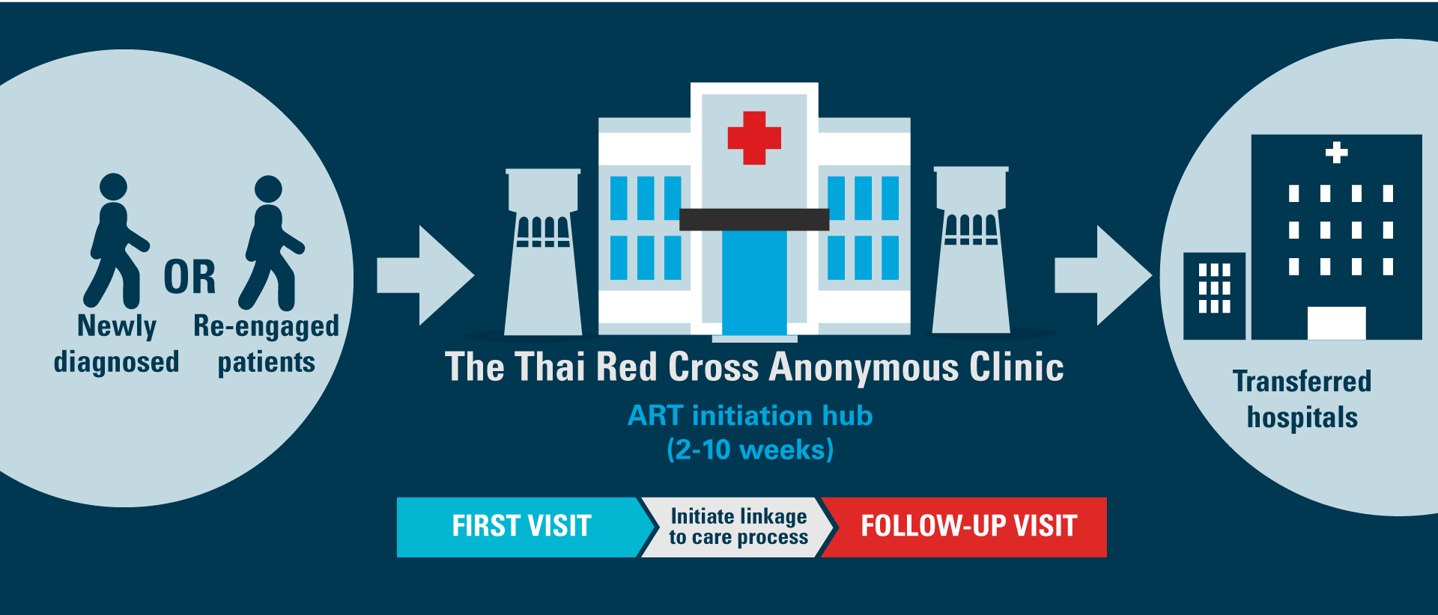
Same-Day ART Initiation to improve the 2nd 90
Notes:
AS: The titles for these slides need to be the same. They are all in different sizes and colors for Same-Day ART. I have revised them all to be more consistent.

Slide 10
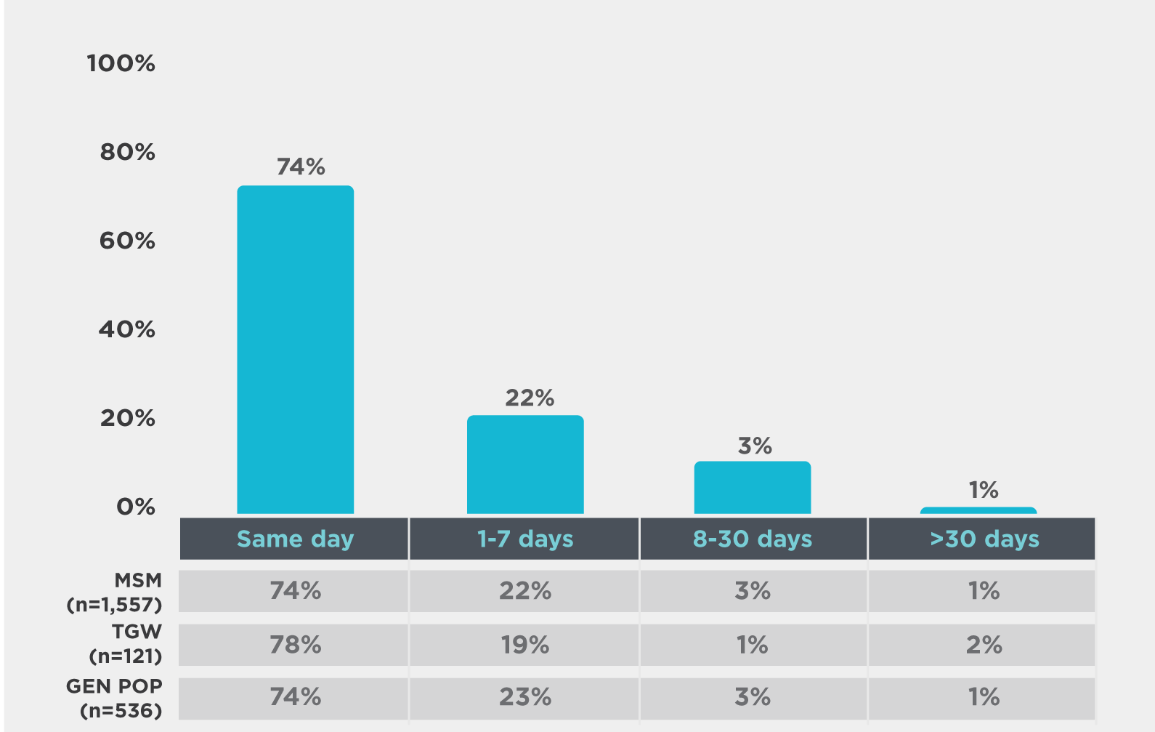
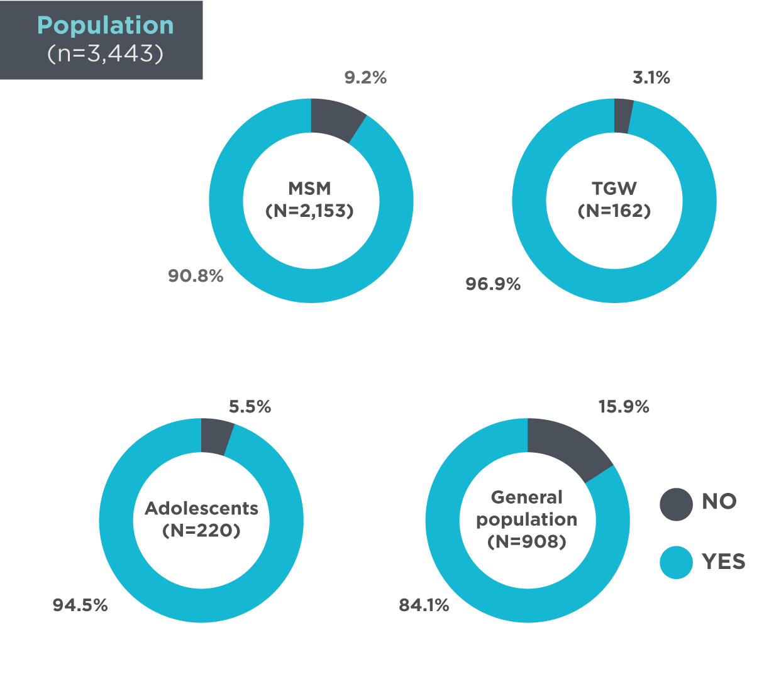
Same-Day ART: Time to ART initiation
Source: Same-Day ART database, Thai Red Cross Anonymous Clinic (July 2017-April 2019).

Slide 11
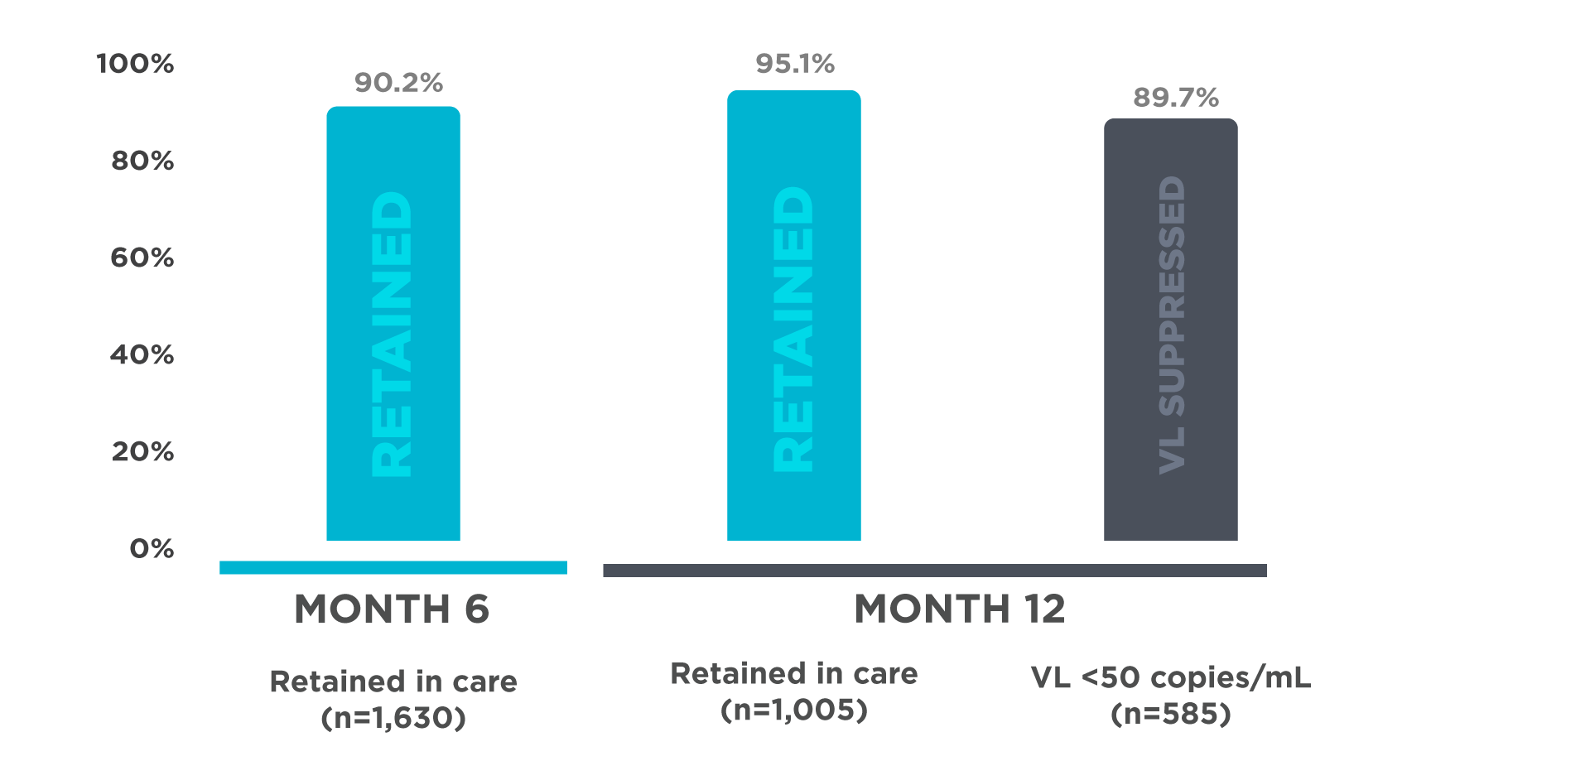
Same-Day ART: Retention and viral load suppression
Source: Same-Day ART database, Thai Red Cross Anonymous Clinic (July 2017-April 2019).

Slide 12

Thailand’s PrEP Programs
iPrEX showed 44% prevention efficacy among MSM with daily TDF/FTC
The 1st Test & Treat project in MSM and TGW in 4 provinces
PrEP-30 at
TRCARC
Princess PrEP
NOV.
2010
DEC.
2012
DEC.
2014
JAN.
2016
The Princess PrEP
The first key population-led PrEP initiative under the royal patronage
Use Thai Red Cross public donation fund and USAID LINKAGES funding to scale-up KP-led PrEP services in CBOs
Aims to serve 1,000 PrEP users per year for 3 years
Started with MSM and TGW, being expanded to FSW and PWID
Will focus more on 15-19 years old in FY2018
JUL.
2011
OCT.
2014
MAY
2015
HPTN 052, 96% prevention efficacy with immediate ART
National guidelines recommended ART regardless of CD4 count and PrEP
Community-Led and Facility-Based Test & Treat projects, along with PrEP substudy in MSM and TGW
PrEP will be included in Thailand UHC starting October 2019
Notes:
PrEP is available for free to key populations under the community-led PrEP program using the money from Thai Red Cross HIV Prevention Public Donation Fund. Her Royal Highness Princess Soamsawali who established this public donation fund, which was originally used for PMTCT, has been kind enough to give her blessing quote to our colleagues in 7 drop-in centers to give courage and support to the community-led PrEP program. This program was therefore named the “Princess PrEP program”.

Slide 13



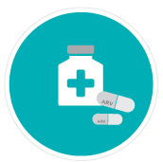

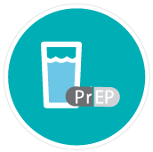
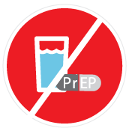



Key Population-Led Same-Day PrEP Services
Start ART immediately
HIV testing
Risk assessment and PrEP counseling process
Behavioral questionnaire
Willing to take PrEP
Not willing to take PrEP
Routine appointment
(at least 6-monthly HIV testing)
More details on PrEP
Referral to renal doctor,
consider re-screening for PrEP, and at least 6-monthly HIV testing
CrCL <60 mL/min
Discontinue PrEP
Provide a bottle of PrEP to start
Continue PrEP
Blood collection for creatinine and HBV antigen testing
CrCl >60 mL/min
Month 1, month 3 and quarterly follow up

Slide 14
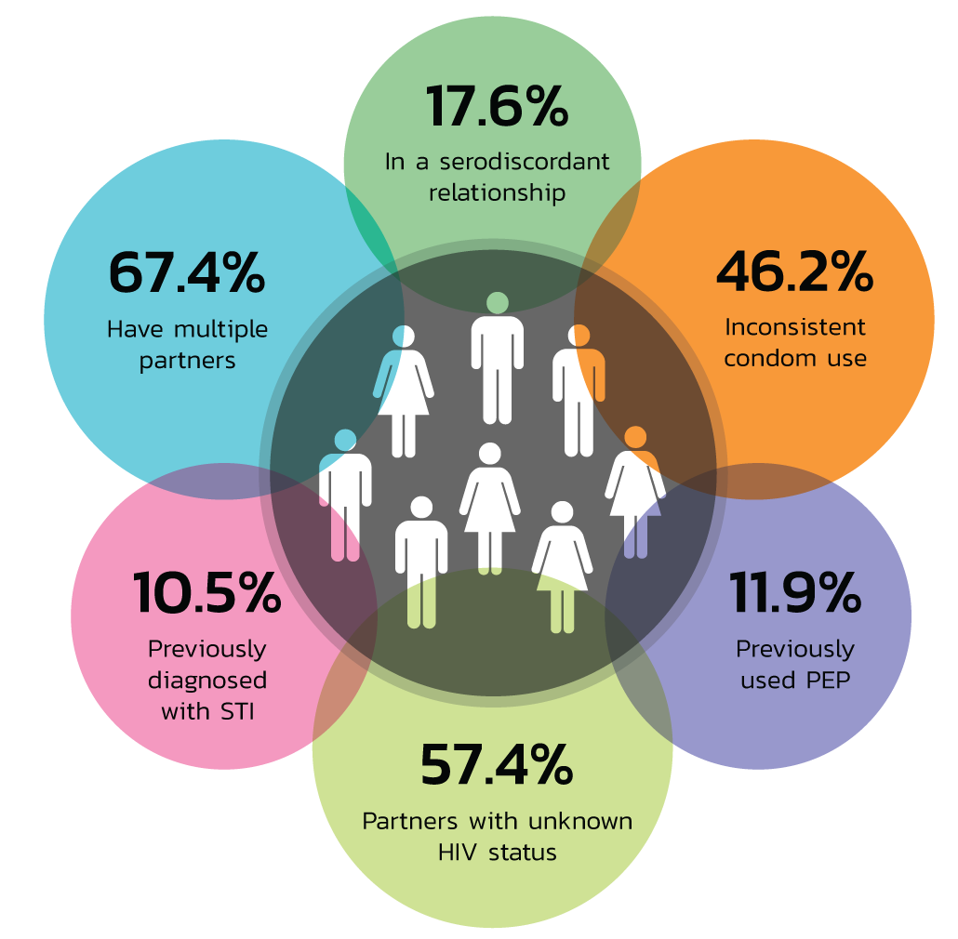
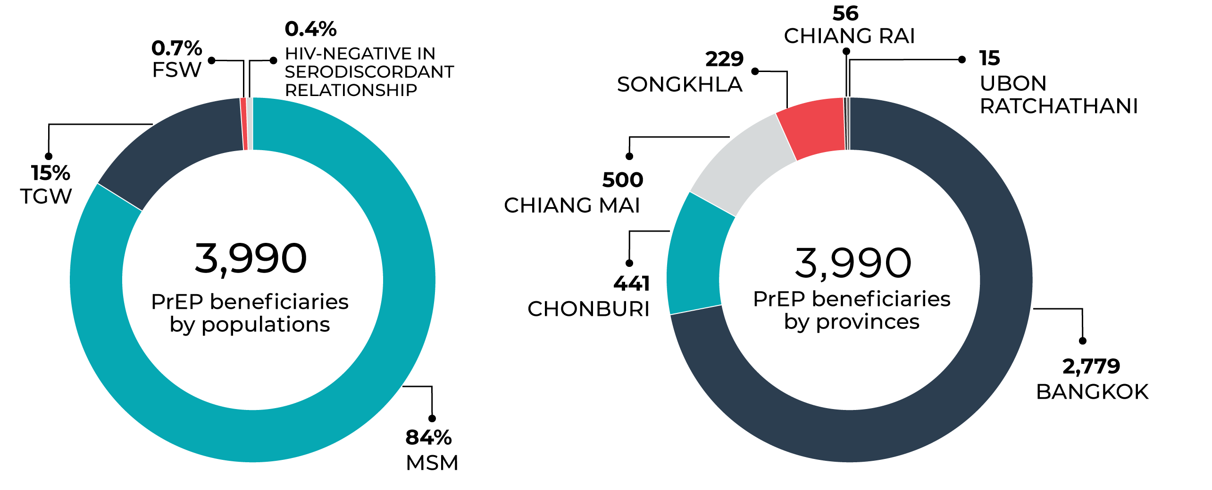
Princess PrEP, dispensed through KPLHS (as of June 12, 2019)

Slide 15
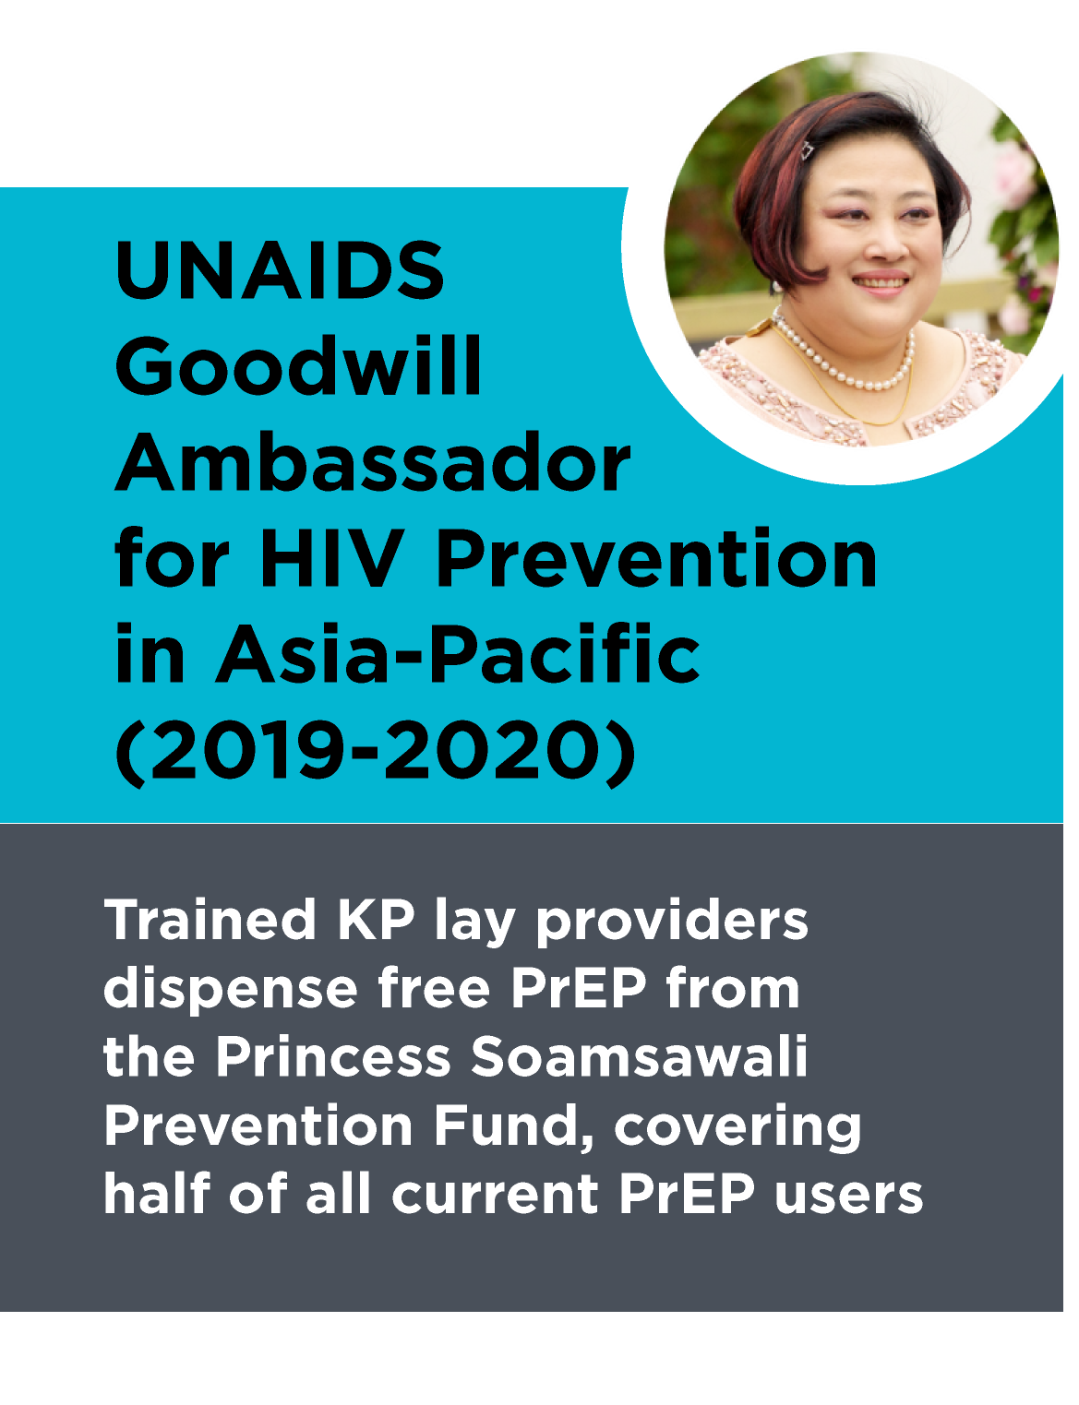
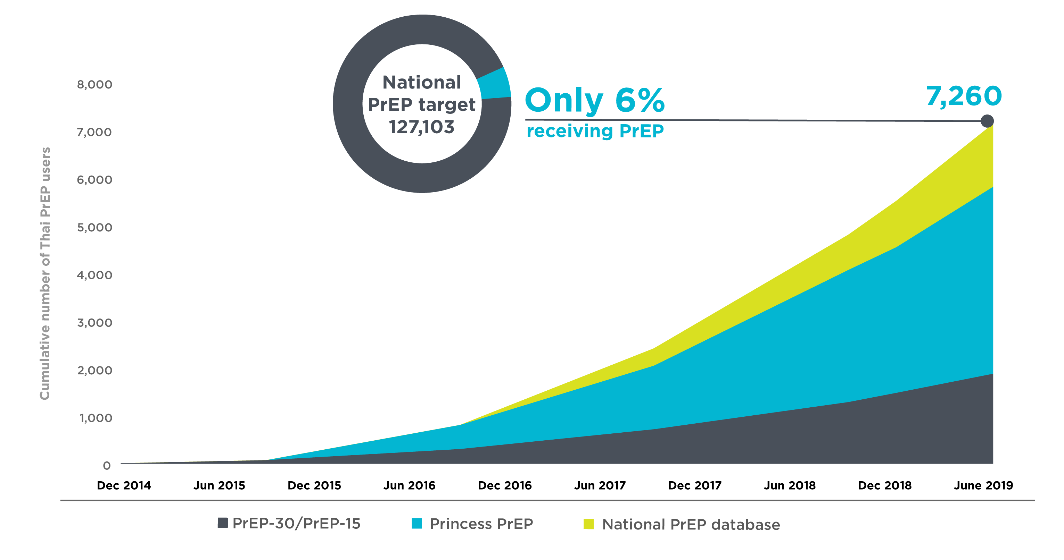
Thailand’s PrEP Programs

Slide 16
Challenges in ending AIDS in Bangkok
Most innovative work in BKK and most of the BKK data came from NGO (TRCARC, SWING, RSAT) which is only a small fraction of the overall healthcare facilities in Bangkok (BMA clinics & hospitals, central government hospitals, university and private hospitals) which means still a lot more can be done.
But, it has not been done or rapidly done, WHY ??
  City politicians seem to be committed but their first and second management levels do not follow it through either because they are too busy or afraid to work hard (since it is 12 years far away) and they are not made accountable to either by their boss or by the central government (since politicians will come and go).
  Too many players or TA’s in BKK with conflicting interest and territory and no ‘CHIEF’ wants to nail it down because of ‘threat’ by the imperial player.

Slide 17















Acknowledgements

